Slide 1
Machine Learning
Lecture 12: Probability Review
Dr. Beilun Wang
Southeast University
School of Computer Science
and Engineering

Slide 2
Today: Probability Review
The big picture
Events and Event spaces
Random variables
Joint probability, Marginalization, conditioning, chain rule, Bayes Rule, law of total probability, etc.
Structural properties, e.g., Independence, conditional independence
Maximum Likelihood Estimation

Slide 3


The Big Picture
Probability
Model
i.e. Data generating process
Observed Data
Estimation / learning / Statistics / Data mining

Slide 4
Probability
Counting
Basics of probability
Conditional probability
Random variables
Discrete and continuous distributions
Expectation and variance
Tail bounds and central limit theorem
……

Slide 5
Statistics
Maximum likelihood estimation
Bayesian estimation
Hypothesis testing
Linear regression
……

Slide 6
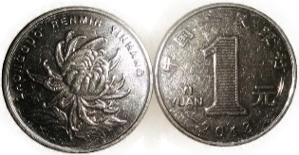

Probability as frequency
Consider the following questions:
What is the probability that when I flip a coin it is “heads”?
What is the probability of Zijin Mountains to have a mudslide in the near future?
➔ 50%
➔ could not count
Message: The frequentist view is very useful, but it seems that we can also use domain knowledge to come up with probabilities.

Slide 7

Probability as a measure of uncertainty
Imagine we are throwing darts at a wall size 1x1 and that all darts are guaranteed to fall within this 1x1 wall.
What is the probability that a dart will hit the shaded area?
(0,1)
(1,1)
(0,0)
(½,0)
(1,0)

Slide 8

Probability as a measure of uncertainty
Probability is a measure of certainty of an event taking place.
i.e. in the example, we were measuring the chances of hitting the shaded area.
_{prob =} # Re dBoxes
# Boxes

Slide 9
Today: Probability Review
The big picture
Events and Event spaces
Random variables
Joint probability, Marginalization, conditioning, chain rule, Bayes Rule, law of total probability, etc.
Structural properties, e.g., Independence, conditional independence
Maximum Likelihood Estimation

Slide 10





Probability
Probability is the formal study of the laws of chance. Probability allows us to manage uncertainty.
The sample space is the set of all outcomes. For example, for a die we have 6 outcomes:
$$O_{die}=\left\{1,2,3,4,5,6\right\}$$
O:
Elementary Event “Throw 2”
The elements of O are called
elementary events.

Slide 11
Probability
Probability allows us to measure many events.
The events are subsets of the sample space O. For example, for a die we may consider the following events: e.g.,
Assign probabilities to these events: e.g.,
GREATER = {5, 6}
EVEN = {2, 4, 6}
P(EVEN) = 1/2

Slide 12
Sample space and Events
Ο: Sample Space,
result of an experiment / set of all outcomes
If you toss a coin twice Ο = {ΗΗ,ΗΤ,ΤΗ,ΤΤ}
Event: a subset of Ο
First toss is head = {HH,HT}
S: Event Space, a set of events:
Contains the empty event and Ο

Slide 13
Axioms for Probability
Sample space
Event space
Defined over (Ο, S) s.t.
1 >= P(α) >= 0 for all α in S
P(Ο) = 1
If Α, Β are disjoint, then
P(Α U Β) = P(Α) + P(Β)

Slide 14
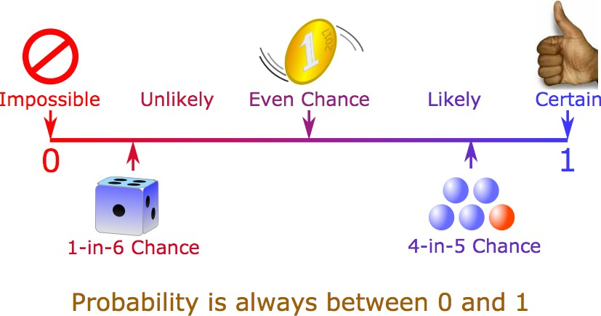
Axioms for Probability

Slide 15

Axioms for Probability
$P\left(O\right)=\sum{P\left(B_{i}\right)=1}$
B₂
B₅
B₄
B₃
B₆
B₁
B₇

Slide 16

OR & AND operation for Probability
We can deduce other axioms from the above ones
Ex: P(Α U Β) for non-disjoint events
$$P\left(A or B\right)=P\left(A\right)+P\left(B\right)−P(A and B)$$
A
B

Slide 17

NOT operation for Probability
$0≤P(A)≤1$
$P\left(A or B\right)=P\left(A\right)+P\left(B\right)−P(A and B)$
From these we can prove:
$$P\left(not A\right)=P\left(\sim A\right)=1−P(A)$$
A

Slide 18

Law of Total Probability
$0≤P(A)≤1$
$P\left(A or B\right)=P\left(A\right)+P\left(B\right)−P(A and B)$
From these we can prove:
$$P\left(A\right)=P\left(A^B\right)+P(A^\sim B)$$
B
A

Slide 19
Today: Probability Review
The big picture
Events and Event spaces
Random variables
Joint probability, Marginalization, conditioning, chain rule, Bayes Rule, law of total probability, etc.
Structural properties, e.g., Independence, conditional independence
Maximum Likelihood Estimation

Slide 20
From Events to Random Variable (RV)
Concise way of specifying attributes of outcomes
Modeling students (Grade and Intelligence):
Ο = all possible students (sample space)
What are events (subset of sample space)
Grade_A = all students with grade A
Grade_B = all students with grade B
HardWorking_Yes = … who works hard
Very cumbersome
Need “functions” that maps from Ο to an attribute space T.
P(H = YES) = P({student ϵ Ο : H(student) = YES})

Slide 21




Random Variables (RV)
Ο
H: hardworking
Yes
No
A
G: Grade
B
A+
P(H = Yes) = P({all students who is working hard on the course})
“functions” that maps from Ο to an attribute space T.

Slide 22
Discrete Random Variables
Random variables (RVs) which may take on only a countable number of distinct values
X is a RV with arity k if it can take on exactly one value out of {x₁, …, x_{k}}

Slide 23





Probability of Discrete RV
Probability mass function (pmf): P(X = x_{i})
Easy facts about pmf
Σ_{i} P(X = x_{i}) = 1
P(X = x_{i} ∩ X = x_{j}) = 0 if i ≠ j
P(X = x_{i} U X = x_{j}) = P(X = x_{i}) + P(X = x_{j}) if i ≠ j
P(X = x₁ U X = x₂ U … U X = x_{k}) = 1
$$x=x_{1}$$
$$x=x_{2}$$
$$\sum_{i=1}^{4}{P\left(X=x_{i}\right)=1}$$
$$x=x_{3}$$
$$x=x_{4}$$

Slide 24


e.g. Coin Flips
You flip a coin
Head with probability p
Binary random variable
Bernoulli trial with success probability p
You flip a coin for k times
How many heads would you expect
Number of heads X is a discrete random variable
Binomial distribution with parameters k and p
$$Binary=\left\{H,T\right\}$$
$$Integer=\left\{1,2,…,k\right\}$$

Slide 25
Discrete Random Variables
Random variables (RVs) which may take on only a countable number of distinct values
E.g. the total number of heads X you get if you flip 100 coins
X is a RV with arity k if it can take on exactly one value out of
E.g. the possible values that X can take on are 0, 1, 2, …, 100
{x₁,…, x_{k} }

Slide 26
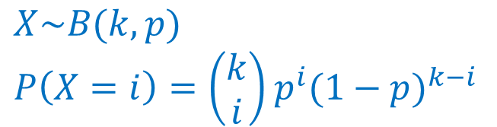

e.g., two common distributions
Uniform
X takes values 1, 2, …, N
E.g. picking balls of different colors from a box
Binomial
X takes values 0, 1, …, k
E.g. coin flips k times
$$X\sim U\left[1,…,N\right]$$
$$P\left(X=i\right)=\frac{1}{N}$$
$$X\sim B(k,p)$$
$$P\left(X=i\right)=\left(\begin{matrix}k \\ i\end{matrix}\right)p^{i}{(1−p)}^{k−i}$$

Slide 27
Today: Probability Review
The big picture
Events and Event spaces
Random variables
Joint probability, Marginalization, conditioning, chain rule, Bayes Rule, law of total probability, etc.
Structural properties, e.g., Independence, conditional independence
Maximum Likelihood Estimation

Slide 28
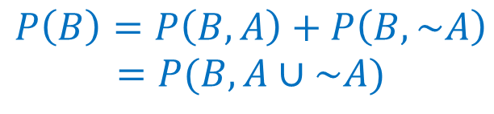

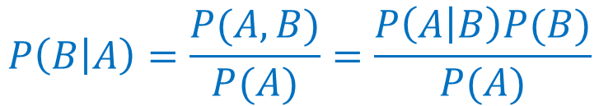
If hard to directly estimate from data, most likely we can estimate
Joint probability
Use Chain Rule
Marginal probability
Use the total law of probability
Conditional probability
Use the Bayes Rule
$$P\left(A,B\right)=P\left(B\right)P\left(A | B\right)$$
$$P\left(B\right)=P\left(B,A\right)+P\left(B,\sim A\right)$$
$$=P(B,A∪\sim A)$$
$$P\left(B | A\right)=\frac{P(A,B)}{P(A)}=\frac{P\left(A | B\right)P(B)}{P(A)}$$

Slide 29
(1) To calculate Joint Probability: Use Chain Rule
Two ways to use chain rules on joint probability
joint
conditional
marginal
P(Α,B) = P(B|A)P(Α)
P(Α,B) = P(A|B)P(Β)

Slide 30
(2) To calculate Marginal Probability: Use Rule of total probability (e.g. event version)
B₅
B₃
B₂
B₄
A
B₁
B₇
B₆
p(A) = ∑P (B_{i} ) P (A | B_{i} )

Slide 31

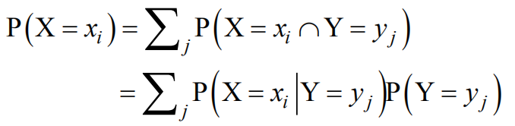

(2) To calculate Marginal Probability: Use Rule of total probability (e.g. RV version)
Given two discrete RVs X and Y, which take values in:
P(A) = P(A^B)+P(A^~B)

Slide 32
(3) To calculate Conditional Probability: Use Bayes Rule (e.g. RV version)
P(X = x ∩ Y = y)
P(Y = y)
P(X = x Y = y) =

Slide 33




One Example: Joint
Assume we have a dark box with 3 red balls and 1 blue ball. That is, we have the set{r, r, r, b}. What is the probability of drawing 2 red balls in the first 2 tries?
$$P\left(B_{1}=r,B_{2}=r\right)=$$

Slide 34
One Example: Marginal
What is the probability that the 2nd ball drawn from the set{r, r, r, b} will be red?
$$P\left(B_{2}=r\right)=$$

Slide 35
One Example: Conditional
What is the probability that the 2nd ball will be red if the 1st ball drawn from the set{r, r, r, b} is red?
$$P\left(B_{2}=r |{ B}_{1}=r\right)=$$

Slide 36
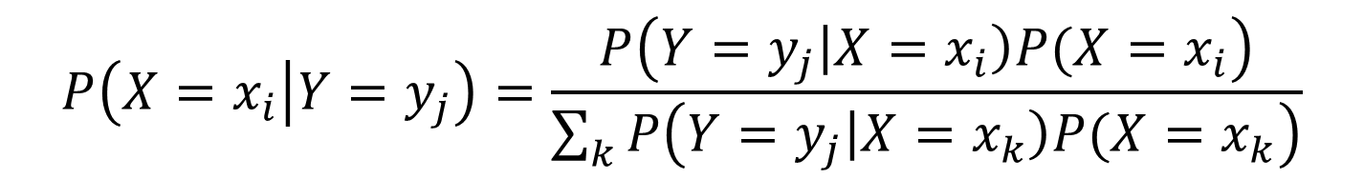
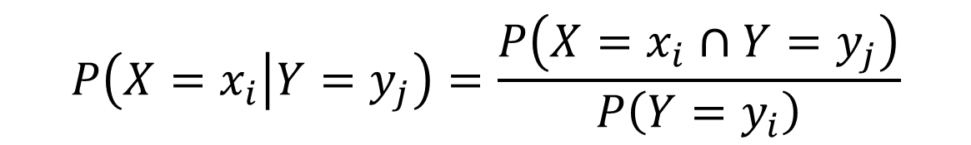

Use both Bayes Rule and Marginal
X and Y are discrete RVs…
$$P\left(X=x_{i} | Y=y_{j}\right)=\frac{P\left(X=x_{i}∩Y=y_{j}\right)}{P\left(Y=y_{i}\right)}$$
$$\{x_{1},…,x_{k}\}$$
$$P\left(X=x_{i} | Y=y_{j}\right)=\frac{P\left(Y=y_{j}\left|X=x_{i}\right)P(X=x_{i}\right)}{\sum_{k}{P\left(Y=y_{j}\left|X=x_{k}\right)P(X=x_{k}\right)}}$$

Slide 37
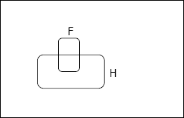
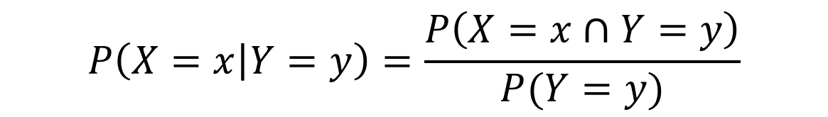

Simplify Notation: Conditional Probability
events
But we will always write it this way:
P(X=x true) -> P(X=x) -> P(x)
$$P\left(X=x | Y=y\right)=\frac{P\left(X=x∩Y=y\right)}{P(Y=y)}$$
$$P\left(x | y\right)=\frac{P\left(x,y\right)}{P(y)}$$
X=x
Y=y

Slide 38

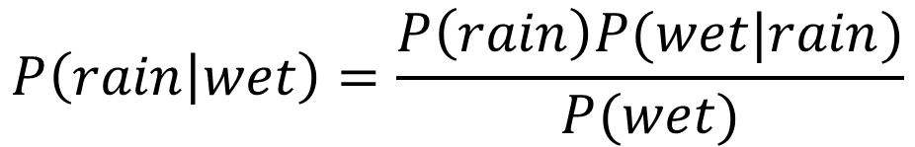
Simplify Notation: An Example of estimating conditional
We know that P(rain) = 0.5
If we also know that the grass is wet, then how this affects our belief about whether it rains or not?
$$P\left(rain | wet\right)=\frac{P\left(rain\right)P(wet|rain)}{P(wet)}$$

Slide 39

Simplify Notation: An Example of estimating conditional
We know that P(rain) = 0.5
If we also know that the grass is wet, then how this affects our belief about whether it rains or not?
$$P\left(rain | wet\right)=\frac{P\left(rain\right)P(wet|rain)}{P(wet)}$$
$$P\left(x | y\right)=\frac{P\left(x\right)P(y|x)}{P(y)}$$

Slide 40
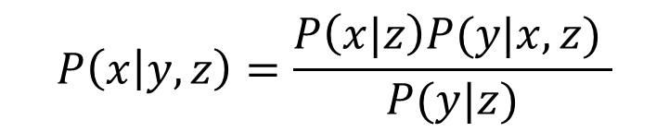
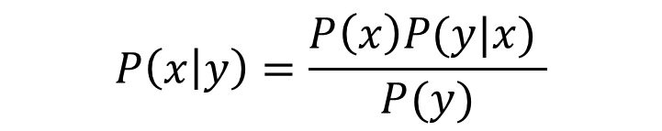
Simplify Notation: Conditional
Bayes Rule
You can condition on more variables
$$P\left(x | y\right)=\frac{P\left(x\right)P(y|x) }{P(y)}$$
$$P\left(x | y,z\right)=\frac{P\left(x|z\right)P(y|x,z) }{P(y|z)}$$

Slide 41


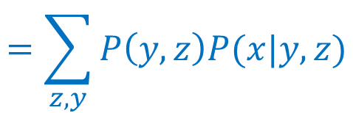

Simplify Notation: Marginal
We know P(X, Y), what is P(Y=y) or P(X=x)?
We can use the law of total probability
$$P\left(x\right)=\sum_{y}{P（x,y）}$$
$$P\left(x\right)=\sum_{y,z}{P（x,y,z）}$$
$$=\sum_{y}{P\left(y\right)P(x|y)}$$
$$=\sum_{z,y}{P\left(y,z\right)P(x|y,z)}$$

Slide 42
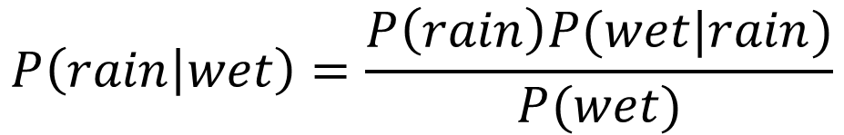
Simplify Notation: An Example
We know that P(rain) = 0.5
If we also know that the grass is wet, then how this affects our belief about whether it rains or not?
0.5
1
$$P\left(rain | wet\right)=\frac{P\left(rain\right)P(wet|rain)}{P(wet)}$$
weather
grass
P(rain)P(rain|wet)
+ P(sunny)P(sunny|wet)
{rain, sunny}
{wet, dry}

Slide 43
Today: Probability Review
The big picture
Events and Event spaces
Random variables
Joint probability, Marginalization, conditioning, chain rule, Bayes Rule, law of total probability, etc.
Structural properties, e.g., Independence, conditional independence
Maximum Likelihood Estimation (next)

Slide 44
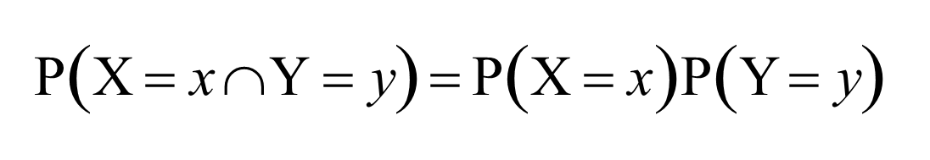
Independent RVs
Definition: X and Y are independent iff

Slide 45
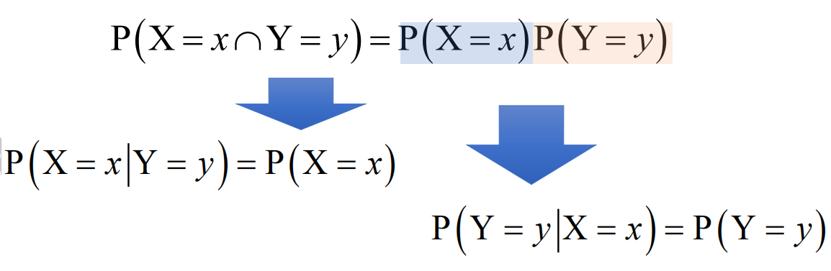
More on Independence
E.g. no matter how many heads you get, your friend
will not be affected, and vice versa

Slide 46
More on Independence
X is independent of Y means that knowing Y does not change our belief about X.
The following forms are equivalent:
P(X=x, Y=y) = P(X=x) P(Y=y)
P(X=x|Y=y) = P(X=x)
The above should hold for all x_{i}, y_{j}
It is symmetric and written as _{X ⊥ Y}

Slide 47

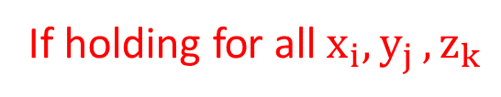


Conditionally Independent RVs
Intuition: X and Y are conditionally independent given Z means that once Z is known, the value of X does not add any additional information about Y
Definition: X and Y are conditionally independent given Z iff
$$Z$$
$$X$$
$$Y$$
If holding for all${ x}_{i}{,y}_{j},z_{k}$
X ⊥ Y | Z

Slide 48
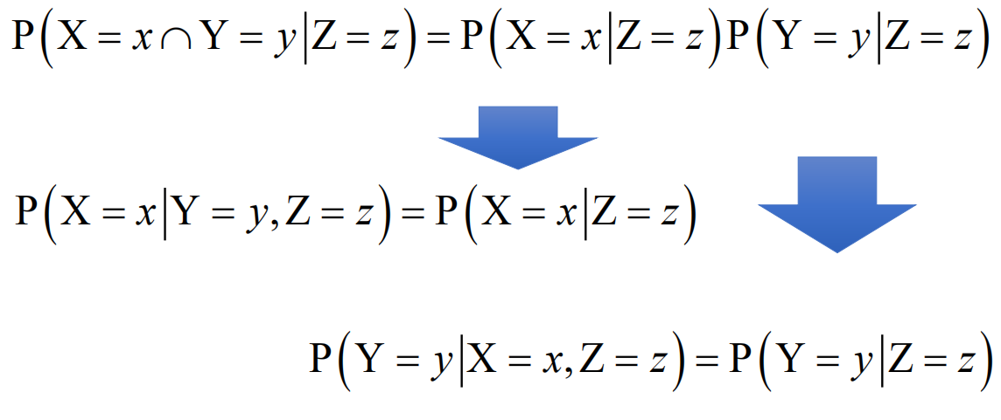
More on Conditional Independence

Slide 49





Independence and Conditional Independence
Independence does not imply conditional independence.
Conditional independence does not imply independence.
Y
$$x_{1}$$
$${ ⋯}_{ }$$
$${ ⋯}_{ }$$
$$x_{p}$$
$$x_{i}$$

Slide 50
Today: Probability Review
The big picture
Events and Event spaces
Random variables
Joint probability, Marginalization, conditioning, chain rule, Bayes Rule, law of total probability, etc.
Structural properties, e.g., Independence, conditional independence
Maximum Likelihood Estimation (next)

Slide 51
References
https://qiyanjun.github.io/2019f-UVA-CS6316-MachineLearning/
Prof. Andrew Moore’s review tutorial
Prof. Nando de Freitas’s review slides
Prof. Carlos Guestrin recitation slides

Slide 52
Thanks for listening

